Slide 1
Boosting contestants performance The Discipline-Monitor Approach
By Eng Mostafa Saad, ICPC World Finalist 2011

Slide 2
Performance problems?
Juniors
Much Training – Weak Performance
Seniors
Plateau Status

Slide 3
HOW ... according to top finalists?
Hard Practice
Practice
Go to 1
Problems Decomposition
No magic - matter of discovering sub-problems you experienced
Just Practice as much as you could
Effective Training
Just practice and practice is not enough
Tough problems requires thinking out of the box
Work on hard problems, think NOT memorize subproblems

Slide 4
Effective training?

Slide 5
Back to Juniors

Slide 6
Problem Solving Phases
Reading
Thinking
Coding
Debugging
ACCEPTED

Slide 7
What actually happens
Reading
Thinking
Coding
Debugging
WA
Thinking
Recoding
Debugging
TLE
Reading
Thinking
Recoding
…
…
ACCEPTED

Slide 8
After solving 3000+ Problem

Slide 9
The Seniors

Slide 10
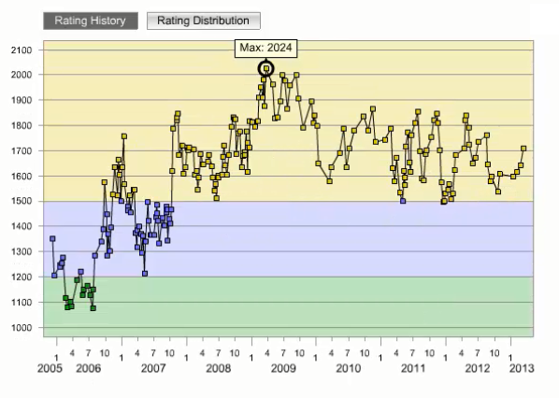
Where?

Slide 11
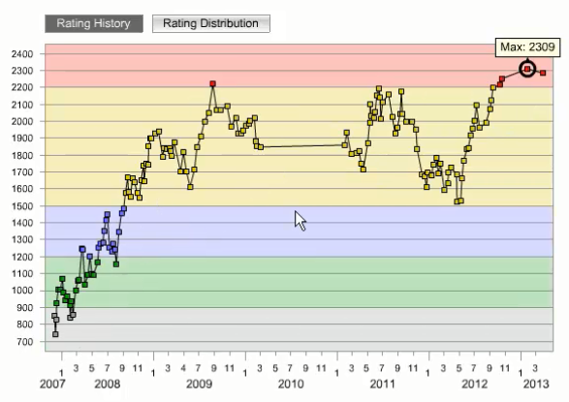
Where?

Slide 12
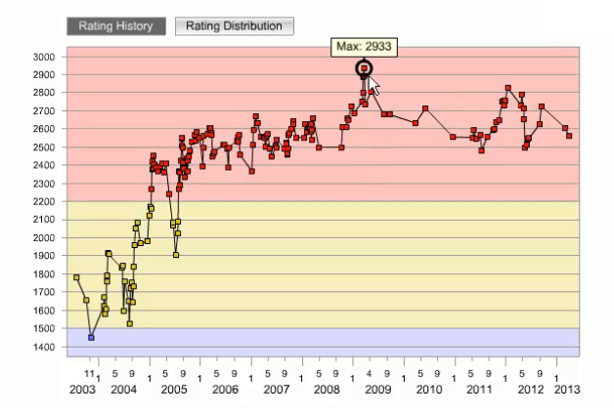
But Not?

Slide 13
Time for Simple
but yet
Powerful approach

Slide 14
Discipline-Monitor
Approach

Slide 15
About How to Behave correctly
NOT how to end correctly
Which comes eventually by itself

Slide 16
The Discipline
Establishing guidelines, rules, or checklist to follow during performing a task.
It is matter of behaving systematically
Develop discipline for everything!
Problem phases (Reading, thinking, solving...)
Training phases
Contest Strategy, etc
Mentality shift is tough to do. Enforcing is a must

Slide 17
Discipline Example
Reading Problem Statement
Read carefully, make sure no statements conflicts
Extract constraints info, don't make assumptions
Record weird constraints
Trace Samples as long as they are traceable
Think in Missed, Boundary & Especial cases
Revise carefully output section and output formats

Slide 18
Passing the Plateau?
It is mainly about thinking skills.
It is tough to think out of the box
Thinking Discipline helps too much

Slide 19
Thinking Discipline
KISS
Think: Problem Simplification
Think: Concretely, Symbolically & Pictorially
Think: Problem Abstraction & Simplification
Think: Divide & Conquer problem
Think: Backward
Rank & Attack Ideas

Slide 20
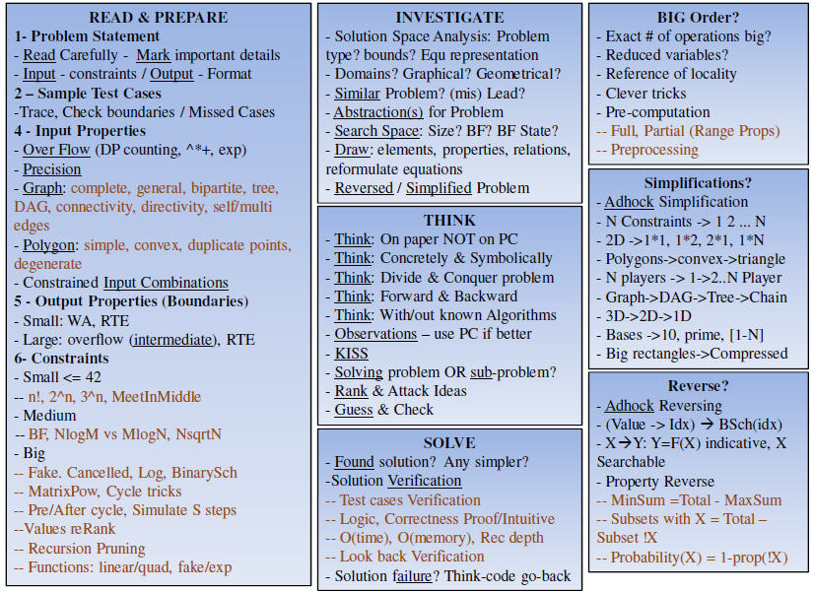
Solving Phases Discipline Cheat Sheet

Slide 21
More Discipline Examples
Google
Algorithms Mostafa Saad YouTube

Slide 22
The Monitor
What if we have a discipline but we don't follow?
Or it doesn't achieve its targets?
How to build it? Update it?
Simply, we need to monitor everything

Slide 23
Log everything
7:00 - Started Reading Problem
7:05 – Prepares the constraints section
7:07 – Tracing sample 1, 2 is long
7:10 – Started Thinking
7:12 – Brute force will TLE, could be optimized?
7:20 – What about greedy? Not comfortable
…
7:40 – Let’s code this DP approach
8:10 – Need to debug!
…..
……..
YES, accepted!

Slide 24
Log analysis
Followed discipline for each phase?
Yes
Which phases are Long?
Performed well?
No, How to update discipline to avoid that?
…. Whatever possible analysis to be better
No, Need more enforcing!

Slide 25
More about
Boosting the performance

Slide 26
Performance Boosting Factors
Major Factors
Problem solving skills
Training Principles
Flat Training Hierarchy
Supporting Factors
Community inside an institution
Community among the institutions

Slide 27
Training Principles
Pump up the challenging spirit
Never to Memorize
Never to use library during training
Practice as if you are in a contest
Depend on variety of training source
Balance the training among different solving skills
Recognize your weakness points, and attack them
Problems in your Zone of proximal development

Slide 28
Training Principles
Pump up the challenging spirit
Work Smart not Hard
Never to Memorize
Never to use library during training
Don't let time stress corrupt your training
Practice as if you are in a contest
Depend on variety of training source
Balance the training among different solving skills
Recognize your weakness points, and attack them
Selective problems to match your Zone of proximal development

Slide 29
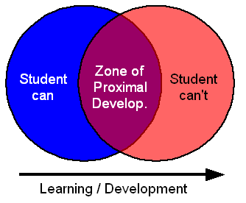
Zone of proximal development

Slide 30
Flat Training Hierarchy
Training might be layered to 3 levels: Juniors, Semi-Seniors and Seniors
Coaches manage seniors. Each senior manages 2-3 semi-seniors. Also Seniors & Semi-Seniors manage the juniors training.
Promotions based on performance

Slide 31
Flat Training Hierarchy-cont’
Coaches should define what are the training plans for all layers. What are the expectations?
Coaches should build software tools to measure different statistics for contestants.
Coaches should define & announce the criteria to select the teams sharing in the formal contests.
Monitoring meeting is done once or twice yearly to review all disciplines based on status.

Slide 32
Junior Training
Training might be 2 levels: Entry, Adhocks
Define for each level its targets and divide it to set of phases
Define Targets: E.g. basic thinking skills, coding skills, basic techniques (E.g. DP, BS..)
Problems should be well selected, to achieve the targets.
Define Expectations: E.g. Stable Green in TC

Slide 33
Semi-Senior Training
Seniors should pick 2-3 survival contestants to work with them
Training style could be: Pairing
Training targets might be
Apply Monitor-Disciple approach extensively
Thinking process > acceptance of a problem
75% is hard ad-hocks vs 25% for knowledge

Slide 34
Seniors Training
Remaining knowledge and experience
Hard problems on algorithms
Working on seniors’ weak points
Individual contests to measure seniors levels
Teams constructions - Establish discipline for contest strategy
After a training contest
Revising the performance of every team. Applying the discipline?
Discuss possible solutions for unsolved problems
Solving form the unsolved problems as possible

Slide 35
Community inside an institution
Community push as many as possible students to join
Attract young students (High schools)
More competing students = much challenge spirit, the fuel to improving performance
The most promising status might be when it is shame to not belong to this community, and if belong to it, it is shame to not be part of its top seniors

Slide 36
Community inside an institution
Each Institution should ease on students academic related issues
Each Institution should maintain the hierarchy
Mainly volunteer work, Hire if necessary
Run camp from time to time by world finals leaders.

Slide 37
Community among institutions
Collaborate together
Yearly meeting for knowledge share
Coaches swapping
Many local warm-up contests should be carried. Similar advices should be applied among Arab countries sharing in ACPC.

